Slide 1


LetuStudy
By: Haoming Xu
Richard Homan
Bayarbat Battseren

Slide 2
Introduction
LetuStudy App - a comprehensive, user-friendly study tool for students
Key Features
Organize study materials
Track learning
Platform
Available on iOS / iPadOS 16 or above
Notes:
Baba

Slide 3
Project Scope
Enhance study view
Localization
Data store
Multiple study sets
Push notifications
Notes:
Fix CardsView
Question and Answer (flipping)
Edit option ( Add or Delete)
UI Enhancements
Improved interface for editing sets
Localization for multiple languages
Local DB Connection
Define DB (SQLite) and ER Diagram
Link DB to StatsView and CardsView
Navigation Stack
Enabled for CardsView across multiple sets
Push Notifications
Integrated for user engagement

Slide 4
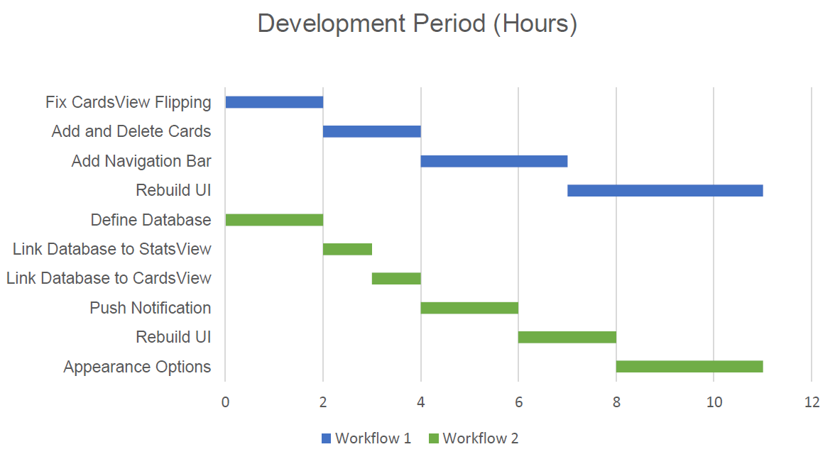
Planned Time Distribution

Slide 5
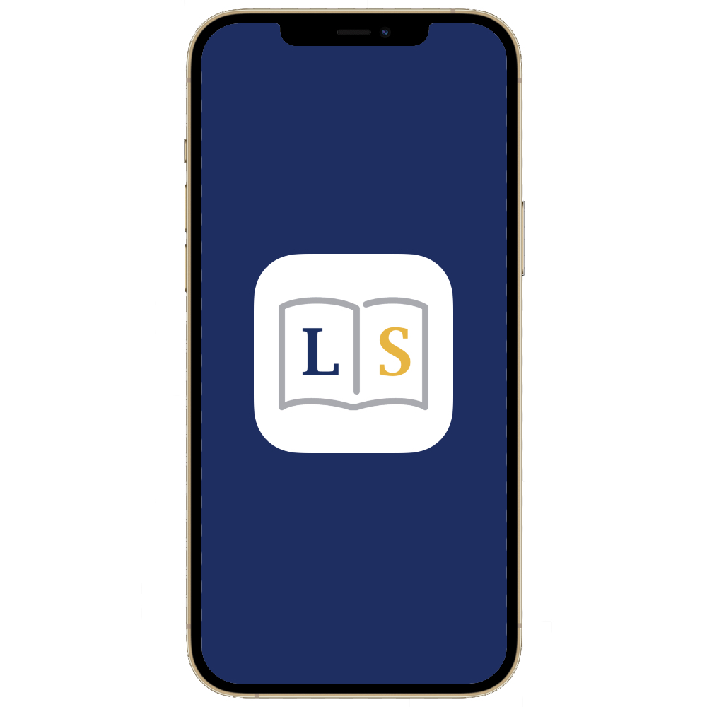

Scope Cut
Home View (calendar)
Settings View
User login/credentials
Cloud services
Notes:
Baba

Slide 6
Actual Accomplishments
Cards view fixes
Cards view modifications
Localization
Multiple study sets
Push Notifications
Saving of study sets
Statistics tracking

Slide 7


Problems Faced
Learning Swift & SwiftUI
Dividing tasks
Interpreting the SDD
Time constraint
More meetings

Slide 8
Demo

Slide 9
THANK YOU!

